Slide 1
Student Account
reset or lost password

Slide 2
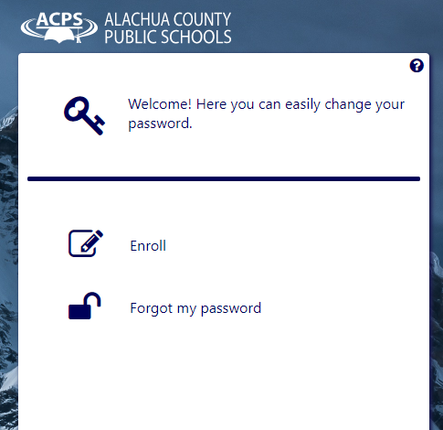
I can’t remember my password!!!
It does not matter if you are on a school or personal computer.
Navigate to https://reset.sbac.edu/
You should see the password reset tool
Select the option for “forgot my password”

Slide 3
I can’t remember my password!!!
Once you select “forgot my password,” you will be asked for your username and then asked three security questions. If you get the questions correct, you will be allowed to change your password.
*If you have not set up your security questions, or you get the questions wrong, you need to contact Kanapaha Middle School at 352-955-6960 to get the password reset.
If you select “enroll” from the password reset tool and know your password, you can create your security questions.
visit https://docs.google.com/document/d/1h2PgYSIF0ikt-kOKg2rwklBFgpR8paGCi5BSfqU8HGI/edit for more info.

